Slide 1






Blockchain
Assignment
Presented by: Ganesh Agrahari
Roll no : 25

Slide 2

Blockchain
Introduction
Definition
Key points
Advantage
disadvantage

Slide 3



Introduction
Block-chain introduction:
Blockchain is a revolutionary technology that underpins digital currencies like Bitcoin, but its applications extend far beyond cryptocurrencies. At its core, blockchain is a distributed ledger system that securely records transactions across a network of computers, making it nearly impossible to alter or tamper with the recorded data.

Slide 4






Definition
Technical Definition:
Blockchain is a chain of blocks, where each block contains a set of transactions or data. These blocks are linked together using cryptographic hashes, ensuring that once data is recorded, it is immutable (cannot be changed or deleted). Each block contains a timestamp, a reference to the previous block (through a hash), and transaction data, forming a secure and transparent record..
Business Definition:
Blockchain is a technology that enables the creation of a secure and transparent digital ledger for transactions. It is particularly valuable for industries like finance, supply chain, and healthcare, where trust, security, and transparency are critical. Blockchain can streamline processes, reduce costs, and eliminate the need for intermediaries..
Cryptocurrency Definition:
Blockchain is the underlying technology behind cryptocurrencies like Bitcoin and Ethereum. It ensures that digital currencies can be transferred directly between parties without the need for a central authority like a bank

Slide 5

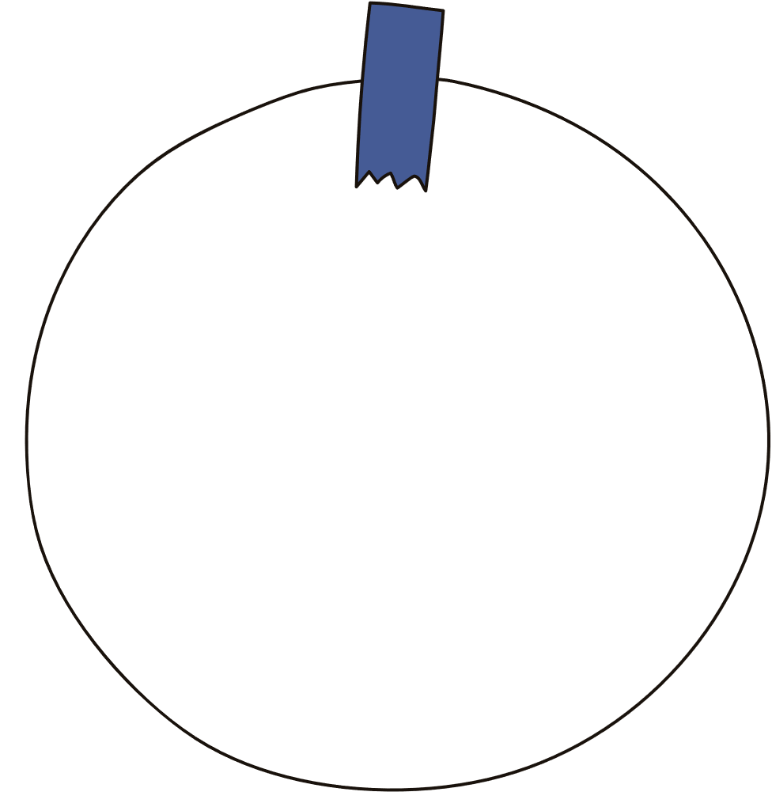







Key points
Immutability
Security
Decentralization
Blockchain uses cryptographic techniques to secure data and transactions. Each block is linked to the previous
Unlike traditional systems that rely on a central authority (like banks or governments), blockchain operates on a decentralized network of computers (nodes)
Once a transaction is recorded in a block and added to the blockchain, it cannot be altered or deleted.
Smart Contracts
Transparency
Smart contracts are self-executing contracts with the terms of the agreement directly written into code.
All transactions on a blockchain are visible to anyone with access to the blockchain
Distributed Ledger
The blockchain is a distributed ledger, meaning that every participant (or node) in the network has a copy of the entire blockchain..

Slide 6


Advantage and disadvantage:
Advantage
Disadvantage
Decentralization: No central authority needed.
Transparency: All transactions are visible.
Security: Highly secure and tamper-proof.
Efficiency: Faster, automated processes.
Cost Reduction: Lower transaction costs.
Scalability Issues: Limited transaction speed.
Energy Consumption: High power usage.
Complexity: Difficult to understand and implement.
Regulatory Uncertainty: Unclear legal frameworks.

Slide 7

Thank's For Attention –GANESH AGRAHARI

